Slide 1
COP509: Natural Language Processing Introduction to NLP
Georgina Cosma

Slide 2
What is NLP?
Natural language processing (NLP) refers to the branch of computer science — and more recently, the branch of artificial intelligence (AI) concerned with giving computers the ability to understand text and spoken words in much the same way human beings can.

Slide 3
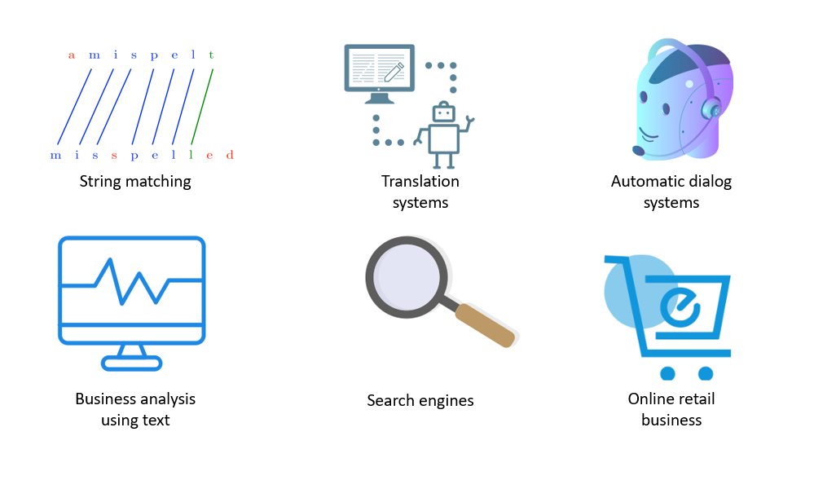
What is NLP?
In the broadest sense, NLP refers to any program that automatically processes human languages
Common real-world examples of such tasks are online chatbots, text summarizers, auto-generated keyword tabs, as well as tools analysing the sentiment of a given text.

Slide 4
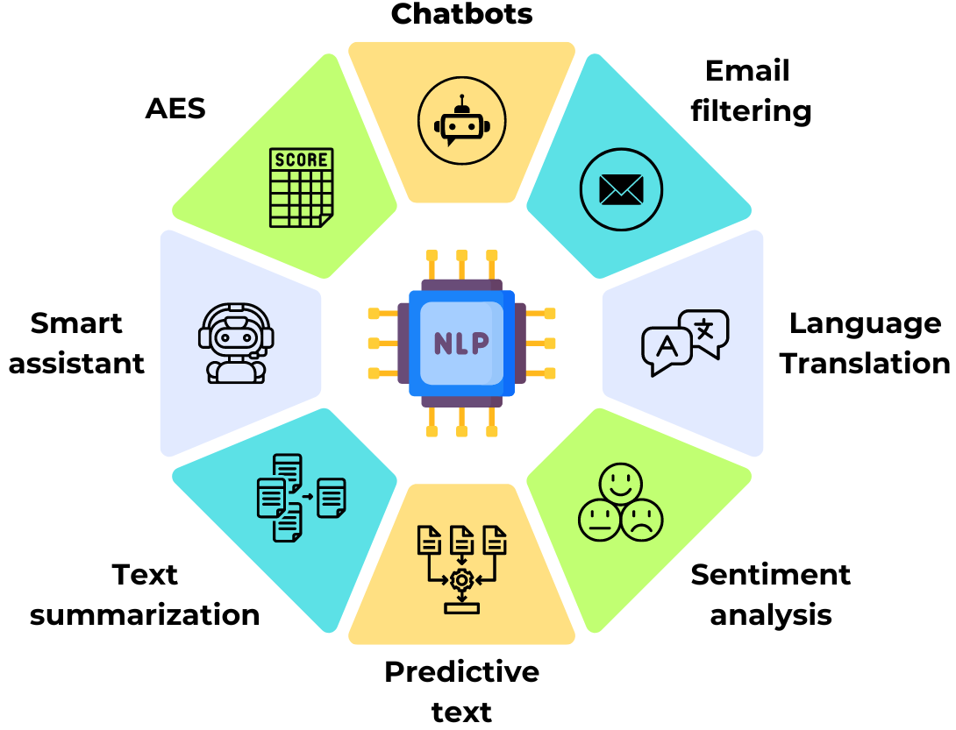
NLP Applications
AI based NLP algorithms detect such things as intent, timing, locations, and sentiments.
Automated Essay Scoring
Source

Slide 5
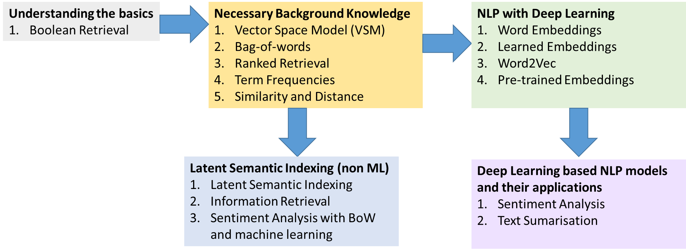

The module’s content - Flow
Why do we need to derive semantic information from text?

Slide 6
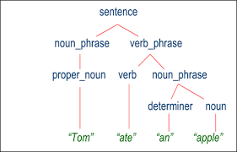
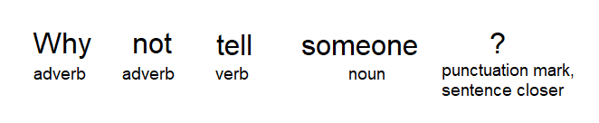
NLP and syntactic analysis
Syntactic analysis can assess how the language aligns with the grammatical rules by applying grammatical rules to a group of words and deriving meaning from them in a number of techniques. Below are just a few of these techniques:
Lemmatization: reducing the inflected forms of a word into a single form for easy analysis. Better→good; am, are, is→be
Stemming: cutting the inflected words to their root form; running→run
Word segmentation: dividing a continuous text into distinct units.['Backgammon', 'is', 'one', 'of', 'the', 'oldest', 'known', 'board', 'games', '.']
Parsing: grammatical analysis of a sentence.
Part-of-speech tagging: identifying the part of speech for every word.
Sentence breaking: placing sentence boundaries on a continuous text.
Parsing and PoS tagging
Notes:
Lemmatisation
The word "better" has "good" as its lemma. This link is missed by stemming, as it requires a dictionary look-up.
The word "walk" is the base form for the word "walking", and hence this is matched in both stemming and lemmatisation.
The word "meeting" can be either the base form of a noun or a form of a verb ("to meet") depending on the context; e.g., "in our last meeting" or "We are meeting again tomorrow". Unlike stemming, lemmatisation attempts to select the correct lemma depending on the context.

Slide 7
Relying on syntactic analysis alone
However….
Grammatical correctness or incorrectness does not always correlate with the validity of a phrase.
Classical example of a meaningless yet grammatical sentence
“colorless green ideas sleep furiously.”
In real life, meaningful sentences often contain minor errors and can be classified as ungrammatical.
Humans compensate error in text and speech through pattern recognition and drawing additional information from the context.
This shows the limitations of syntax-focused analysis and the need for a closer focus on multilevel semantics.

Slide 8
Semantic Analysis
Semantic analysis,involves applying computer algorithms to understand the meaning and interpretation of words and is not yet fully resolved.
Here are some techniques in semantic analysis:
To fully understand the natural language, machines need to take into account the semantic meaning, the intended message, or understanding of what the text is trying to achieve (context).
This level is called pragmatic analysis, which is only beginning to be introduced into NLP techniques.
At present, we can see it to a certain extent in the sentiment analysis: assessment of the negative/positive/neutral feelings contained in the text.
Named entity recognition (NER): determining the parts of a text that can be identified and categorized into preset groups.
Natural language generation: the use of artificial intelligence (AI) programming to produce written or spoken narratives from a data set.
Word sense disambiguation: as the ability to determine which meaning of word is activated by the use of word in a particular context.

Slide 9

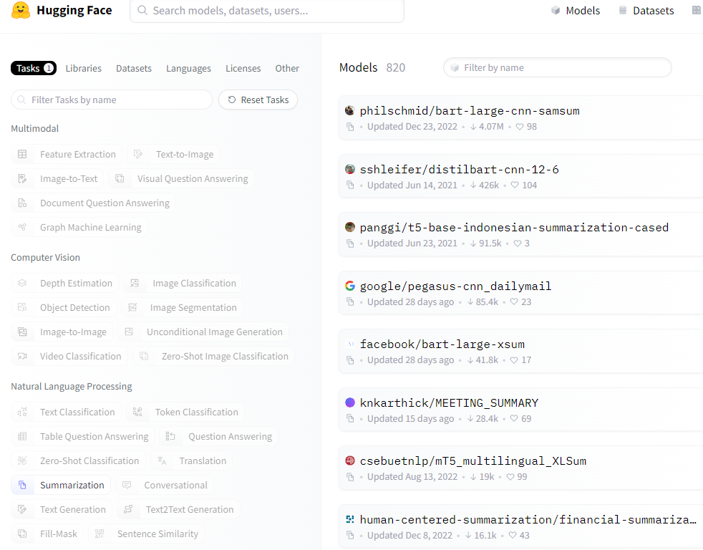
NLP Applications
Let’s look at: https://huggingface.co/models
What is HuggingFace?
Explore the NLP models
What can NLP be useful for? What do these models do?
Explore these models

Slide 10

GPT3
Github page: https://github.com/openai/gpt-3
“GPT-3 is a Generative Pretrained Transformer or “GPT”-style autoregressive language model with 175 billion parameters. Researchers at OpenAI developed the model to help us understand how increasing the parameter count of language models can improve task-agnostic, few-shot performance. Once built, we found GPT-3 to be generally useful and thus created an API to safely offer its capabilities to the world, so others could explore them for commercial and scientific purposes.”
Few-shot learning (FSL) is a hot topic in machine learning where the model makes predictions based on a few training examples.
One-Shot Learning (OSL), we only have a single sample of each class.
FSL has two to five samples per each class, making it just a more flexible version of OSL.
Check out the GPT3 model card? What is a model card? Have you heard of this concept before?
https://github.com/openai/gpt-3/blob/master/model-card.md
Model cards: https://arxiv.org/pdf/1810.03993.pdf

Slide 11
GPT4
OpenAI had not publicly disclosed the specific details about the number of parameters in GPT-4.
It’s predecessor, GPT-3, has 175 billion parameters, making it one of the largest language models at the time of its release.
GPT-4 could have more than 175 billion parameters. However, without official information from OpenAI, any specific number would be speculative.
The number of parameters in a model like GPT-4 is a key factor in its ability to understand and generate human-like text, but it's also important to note that the effectiveness of a model is not solely determined by its size.
Improvements in training techniques, data quality, and architectural innovations also play crucial roles in enhancing the model's performance and efficiency.
GPT4-System Card
Website: GPT4
GPT4
Notes:
OpenAI had not publicly disclosed the specific details about the number of parameters in GPT-4. For context, its predecessor, GPT-3, has 175 billion parameters, making it one of the largest language models at the time of its release.
Given the trend in increasing the number of parameters with each successive generation to improve performance and capabilities, it's reasonable to speculate that GPT-4 would have more than 175 billion parameters. However, without official information from OpenAI, any specific number would be speculative.
The number of parameters in a model like GPT-4 is a key factor in its ability to understand and generate human-like text, but it's also important to note that the effectiveness of a model is not solely determined by its size.
Improvements in training techniques, data quality, and architectural innovations also play crucial roles in enhancing the model's performance and efficiency.

Slide 12
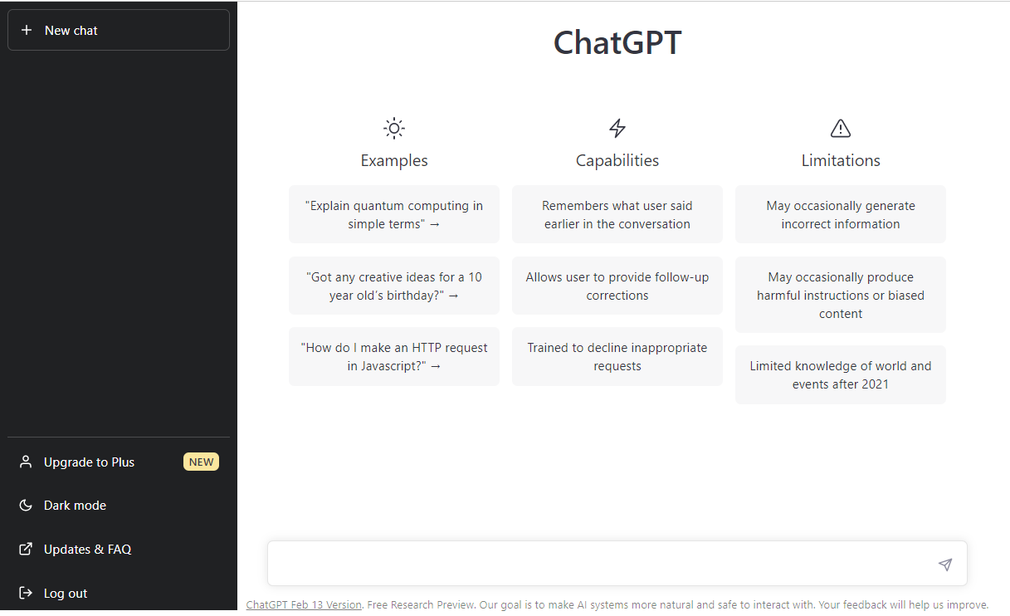
ChatGPT

Slide 13
ChatGPT
How ChatGPT Works: The Model Behind The Bot
All GPT models leverage the transformer architecture, which means they have an encoder to process the input sequence and a decoder to generate the output sequence.
Both the encoder and decoder have a multi-head self-attention mechanism that allows the model to differentially weight parts of the sequence to infer meaning and context.
In addition, the encoder leverages masked-language-modeling to understand the relationship between words and produce more comprehensible responses.
Masked language modeling predicts a masked token in a sequence, and the model can attend to tokens bidirectionally.

Slide 14
ChatGPT
How ChatGPT Works: The Model Behind The Bot
The self-attention mechanism that drives GPT works by converting tokens (pieces of text, which can be a word, sentence, or other grouping of text) into vectors that represent the importance of the token in the input sequence. To do this, the model,
Creates a query, key, and value vector for each token in the input sequence.
Calculates the similarity between the query vector from step one and the key vector of every other token by taking the dot product of the two vectors.
Generates normalized weights by feeding the output of step 2 into a softmax function.
Generates a final vector, representing the importance of the token within the sequence by multiplying the weights generated in step 3 by the value vectors of each token.

Slide 15
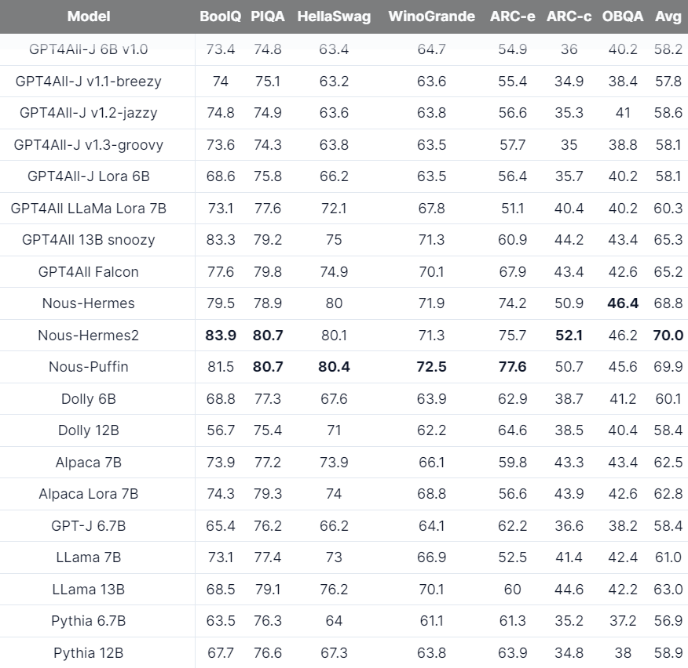
GPT4All
A free-to-use, locally running, privacy-aware chatbot. No GPU or internet required.
Have a look at the page and the performance benchmarks: https://gpt4all.io/index.html

Slide 16
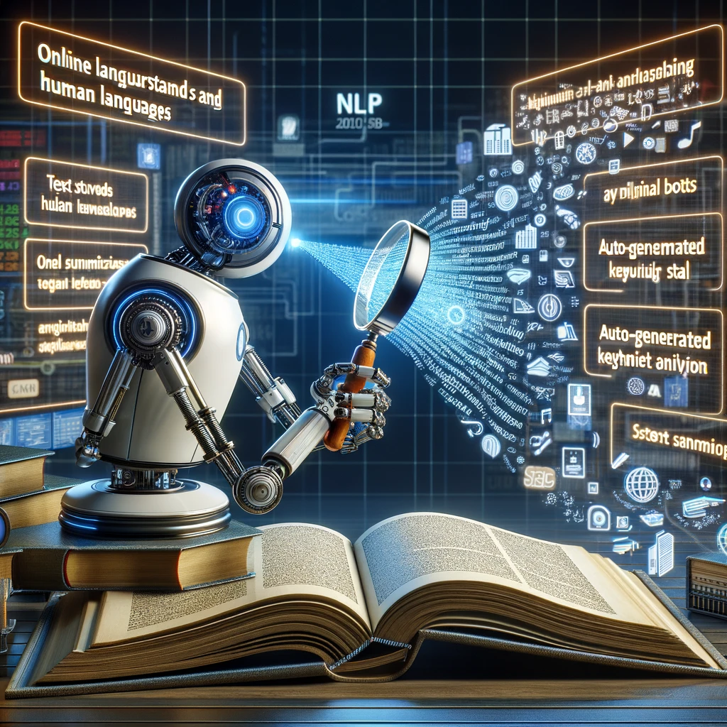
DALL-E for generating images using text prompts
Issues with text.

Slide 17


Slide 18
Let’s have a look at the lab tutorial
Metamorphosis by Franz Kafka download and save instructions
In this tutorial, you will use the text from the book Metamorphosis by Franz Kafka.
The full text for Metamorphosis is available for free from Project Gutenberg. Metamorphosis by Franz Kafka on Project Gutenberg
ASCII text version - Metamorphosis by Franz Kafka Plain Text UTF-8 (may need to load the page twice).
Download the file (or right click on the ASCII link and save as)
Place it in your current working directory with the file name “metamorphosis.txt“.
Open the file and delete the header and footer information (specifically copyright and license information) and save the file as “metamorphosis_clean.txt“.
The start of the clean file should look like:
One morning, when Gregor ....
The file should end with: And, as if in confirmation of their new dreams and good intentions, a... Poor Gregor…
How to Clean Text for Machine Learning with Python
You will discover how you can clean and prepare your text ready for modeling. After completing this tutorial, you will know:
How to get started by developing your own very simple text cleaning tools.
How to take a step up and use the more sophisticated methods in the NLTK library.
How to prepare text when using modern text representation methods like word embeddings.
Tutorial Overview This tutorial is divided into 6 parts; they are:
Metamorphosis by Franz Kafka
Text Cleaning is Task Specific
Manual Tokenization
Tokenization and Cleaning with NLTK
Additional Text Cleaning Considerations
Tips for Cleaning Text for Word Embedding

Slide 19
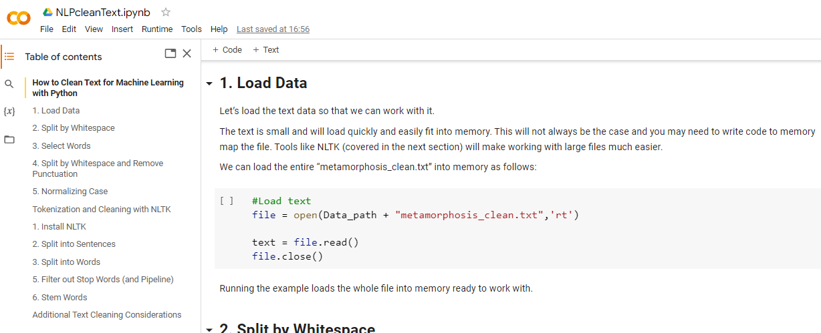
Let’s have a look at the tutorial activity
You can see the table of contents from here.
Let’s go through the tutorial and lab activities.
It is really important you keep up with these tutorials and labs, the module will get progressively more and more complex.

Slide 20
What are the reasons for examining text data before beginning the cleaning process in natural language processing tasks?
Understanding the Data
Identify language, special characters, and anomalies.
Essential for crafting the cleaning strategy.
Identifying Noise
Recognize irrelevant symbols and formatting characters.
Determine what constitutes noise for specific tasks.
Preserving Meaningful Information
Decide on the importance of elements like emojis and punctuation.
Crucial for sentiment analysis and maintaining sentence integrity.
Customizing Cleaning Steps
Text data varies across sources; requires tailored approaches.
Literary vs. social media text demands different handling.
Efficiency and Effectiveness
Choose efficient tools/methods for cleaning.
Save time and resources, improve accuracy.
Data Integrity and Quality
Ensure cleaning doesn’t remove essential information.
Maintain the richness and nuances of the original text.
Let’s have a look at the tutorial sheet

Slide 21

Thank you
I hope you enjoy the module.
Feedback is welcome

